Slide 1
The
iasc gender with age marker
October 2019
Notes:
The new IASC Gender with Age Marker was launched in June 2018, and is now a mandatory part of the Humanitarian Program Cycle for all IASC & UN Agencies and their partners.
It replaces the old gender marker, which is no longer used.

Slide 2
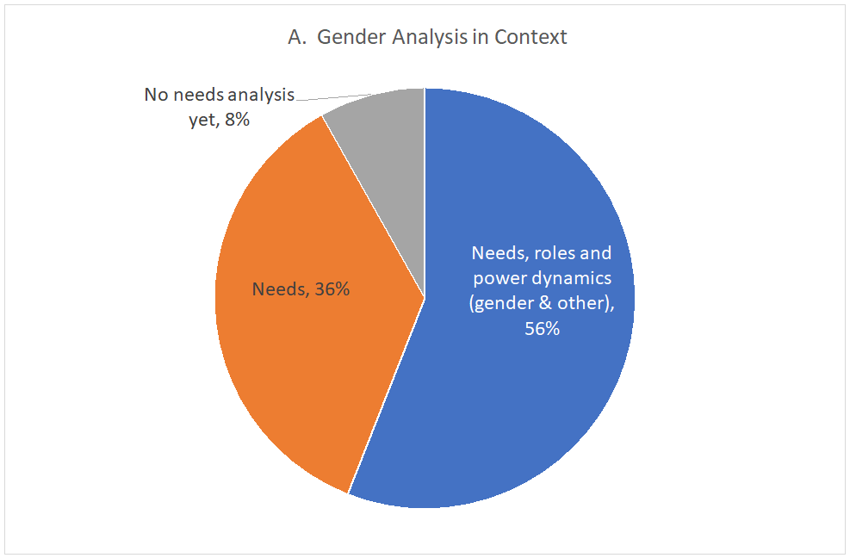

Slide 3
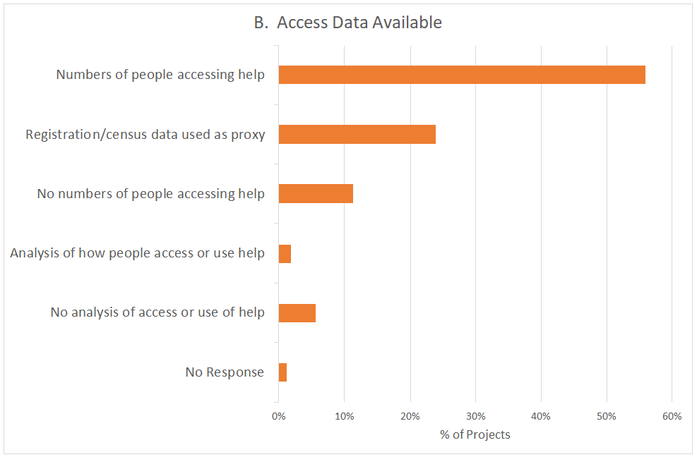

Slide 4
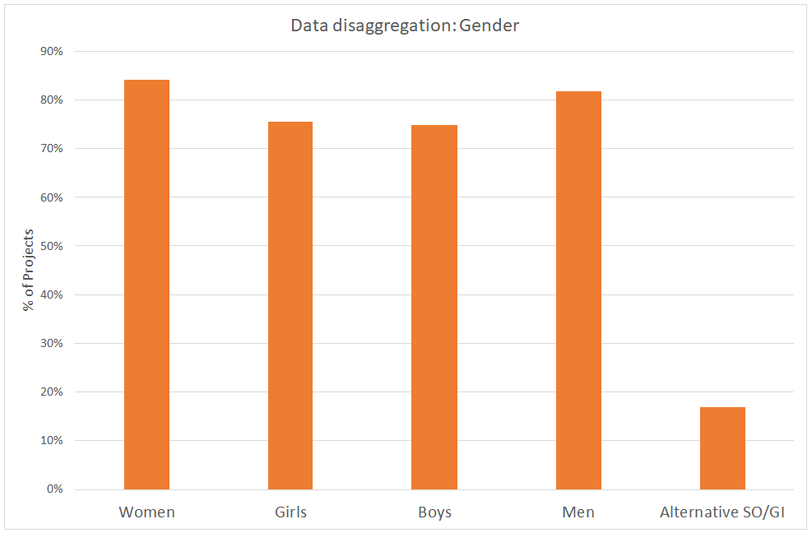
Notes:
These are things that OCHA and many other organizations committed to reporting on under the Grand Bargain PACT agreement. The GAM is the only tool that currently provides data on many aspects of program quality.
Following is a sample of recent monitoring results, showing how GAM helps meet the increasing demand for quantitative information on gender equality in humanitarian response.

Slide 5
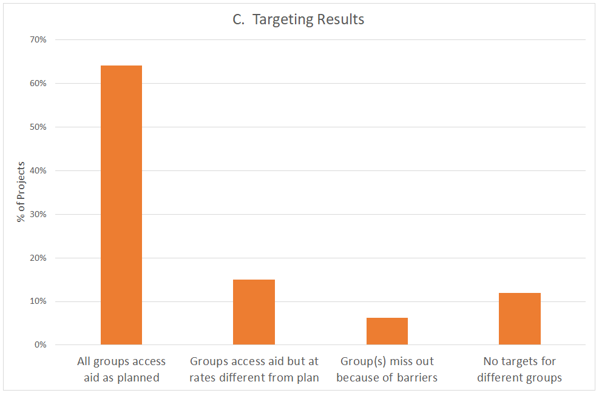
Notes:
These are things that OCHA and many other organizations committed to reporting on under the Grand Bargain PACT agreement. The GAM is the only tool that currently provides data on many aspects of program quality.
Following is a sample of recent monitoring results, showing how GAM helps meet the increasing demand for quantitative information on gender equality in humanitarian response.

Slide 6
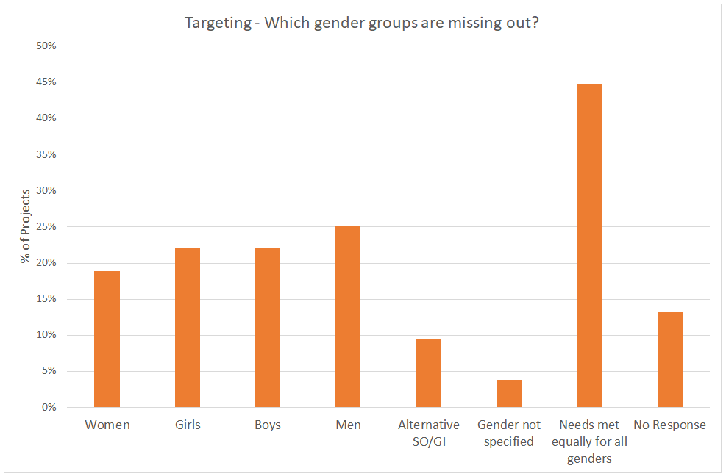
Notes:
These are things that OCHA and many other organizations committed to reporting on under the Grand Bargain PACT agreement. The GAM is the only tool that currently provides data on many aspects of program quality.
Following is a sample of recent monitoring results, showing how GAM helps meet the increasing demand for quantitative information on gender equality in humanitarian response.

Slide 7
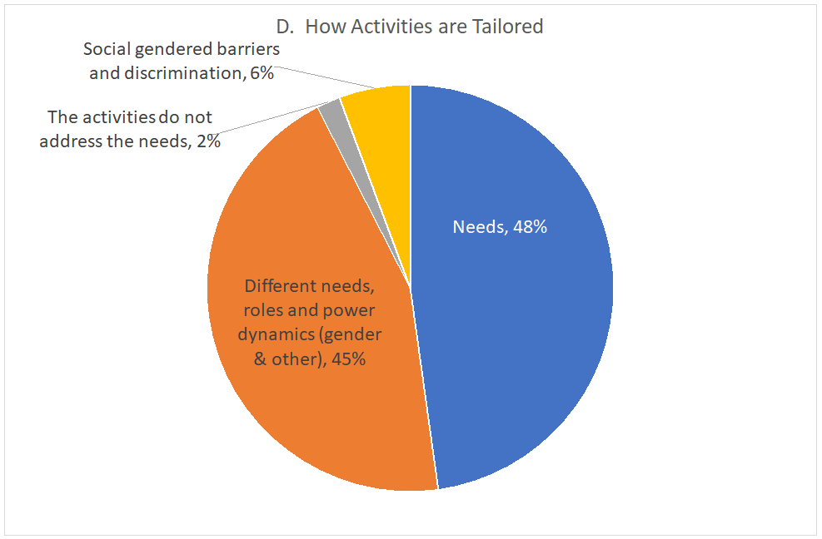
Notes:
These are things that OCHA and many other organizations committed to reporting on under the Grand Bargain PACT agreement. The GAM is the only tool that currently provides data on many aspects of program quality.
Following is a sample of recent monitoring results, showing how GAM helps meet the increasing demand for quantitative information on gender equality in humanitarian response.

Slide 8
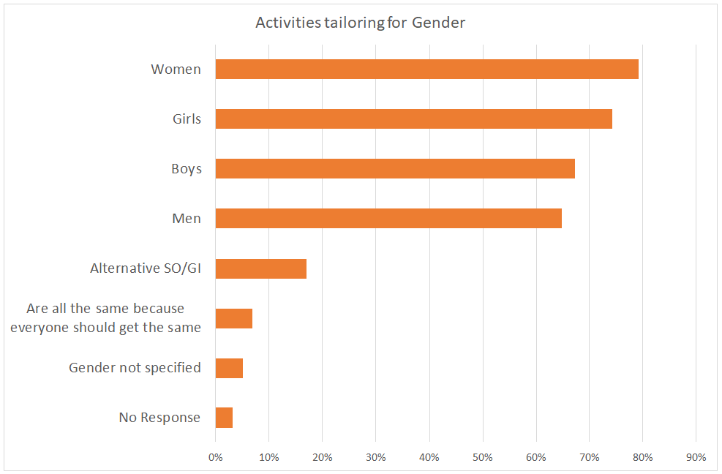
Notes:
These are things that OCHA and many other organizations committed to reporting on under the Grand Bargain PACT agreement. The GAM is the only tool that currently provides data on many aspects of program quality.
Following is a sample of recent monitoring results, showing how GAM helps meet the increasing demand for quantitative information on gender equality in humanitarian response.

Slide 9
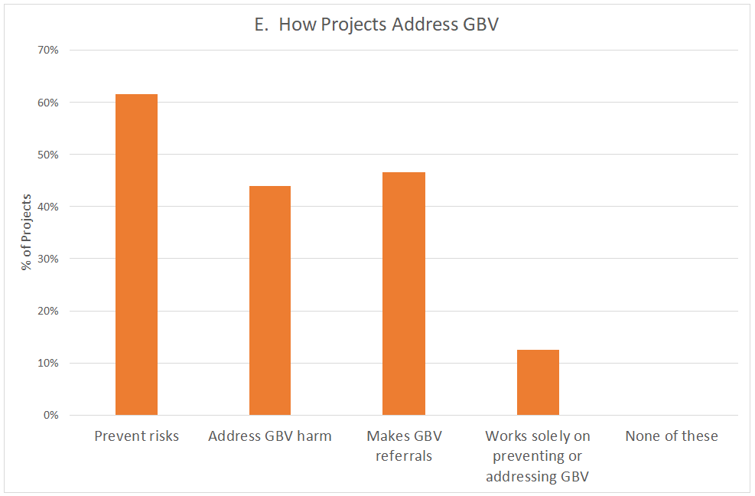
Notes:
These are things that OCHA and many other organizations committed to reporting on under the Grand Bargain PACT agreement. The GAM is the only tool that currently provides data on many aspects of program quality.
Following is a sample of recent monitoring results, showing how GAM helps meet the increasing demand for quantitative information on gender equality in humanitarian response.

Slide 10
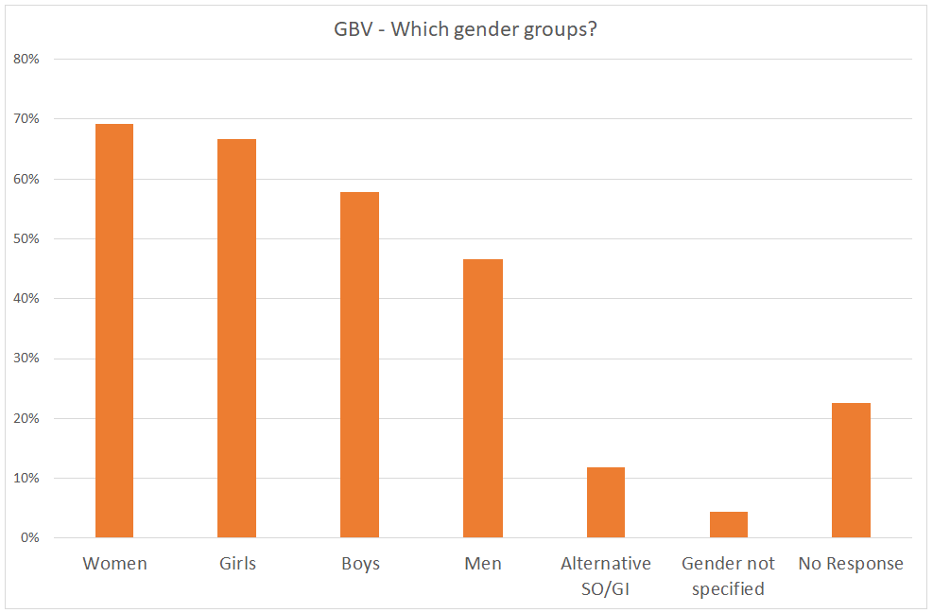
Notes:
These are things that OCHA and many other organizations committed to reporting on under the Grand Bargain PACT agreement. The GAM is the only tool that currently provides data on many aspects of program quality.
Following is a sample of recent monitoring results, showing how GAM helps meet the increasing demand for quantitative information on gender equality in humanitarian response.

Slide 11
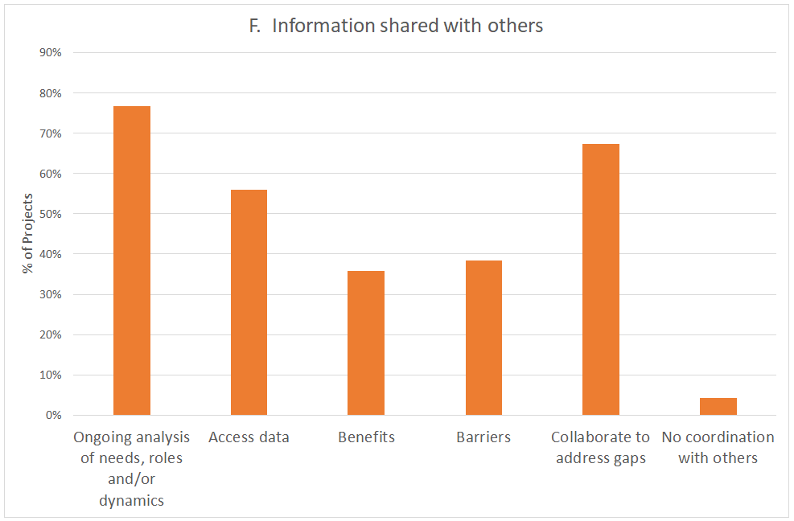
Notes:
These are things that OCHA and many other organizations committed to reporting on under the Grand Bargain PACT agreement. The GAM is the only tool that currently provides data on many aspects of program quality.
Following is a sample of recent monitoring results, showing how GAM helps meet the increasing demand for quantitative information on gender equality in humanitarian response.

Slide 12
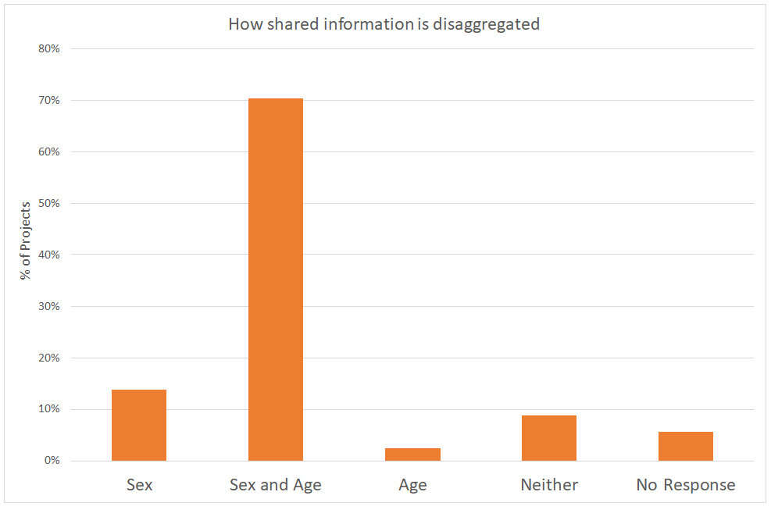
Notes:
These are things that OCHA and many other organizations committed to reporting on under the Grand Bargain PACT agreement. The GAM is the only tool that currently provides data on many aspects of program quality.
Following is a sample of recent monitoring results, showing how GAM helps meet the increasing demand for quantitative information on gender equality in humanitarian response.

Slide 13
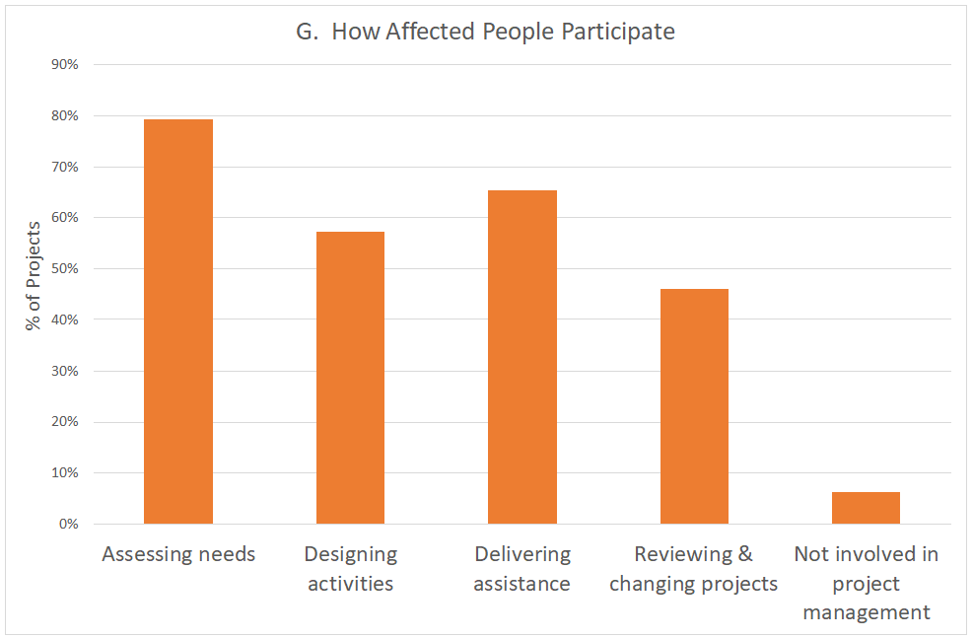
Notes:
These are things that OCHA and many other organizations committed to reporting on under the Grand Bargain PACT agreement. The GAM is the only tool that currently provides data on many aspects of program quality.
Following is a sample of recent monitoring results, showing how GAM helps meet the increasing demand for quantitative information on gender equality in humanitarian response.

Slide 14
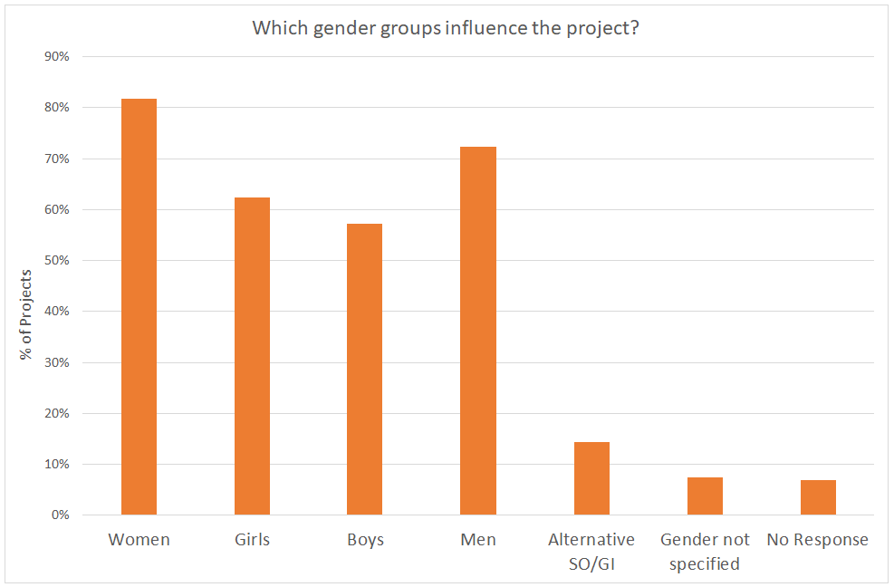
Notes:
These are things that OCHA and many other organizations committed to reporting on under the Grand Bargain PACT agreement. The GAM is the only tool that currently provides data on many aspects of program quality.
Following is a sample of recent monitoring results, showing how GAM helps meet the increasing demand for quantitative information on gender equality in humanitarian response.

Slide 15
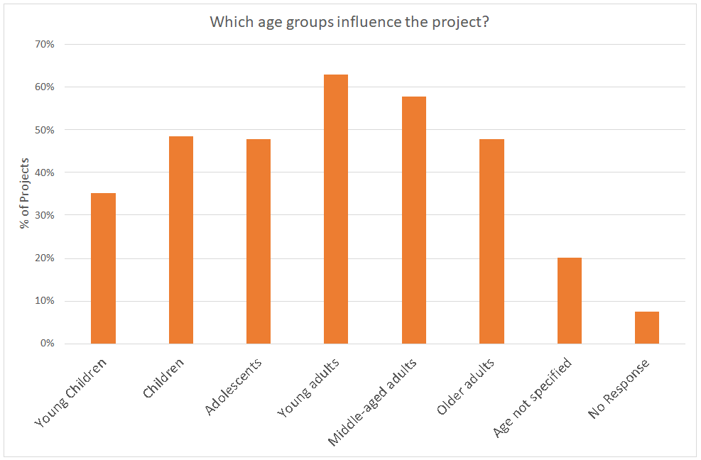
Notes:
These are things that OCHA and many other organizations committed to reporting on under the Grand Bargain PACT agreement. The GAM is the only tool that currently provides data on many aspects of program quality.
Following is a sample of recent monitoring results, showing how GAM helps meet the increasing demand for quantitative information on gender equality in humanitarian response.

Slide 16
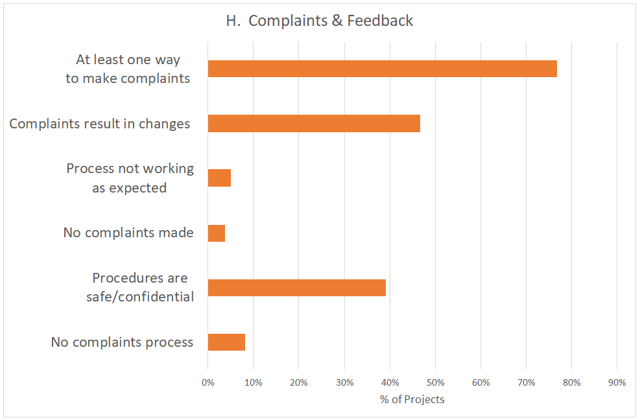
Notes:
These are things that OCHA and many other organizations committed to reporting on under the Grand Bargain PACT agreement. The GAM is the only tool that currently provides data on many aspects of program quality.
Following is a sample of recent monitoring results, showing how GAM helps meet the increasing demand for quantitative information on gender equality in humanitarian response.

Slide 17
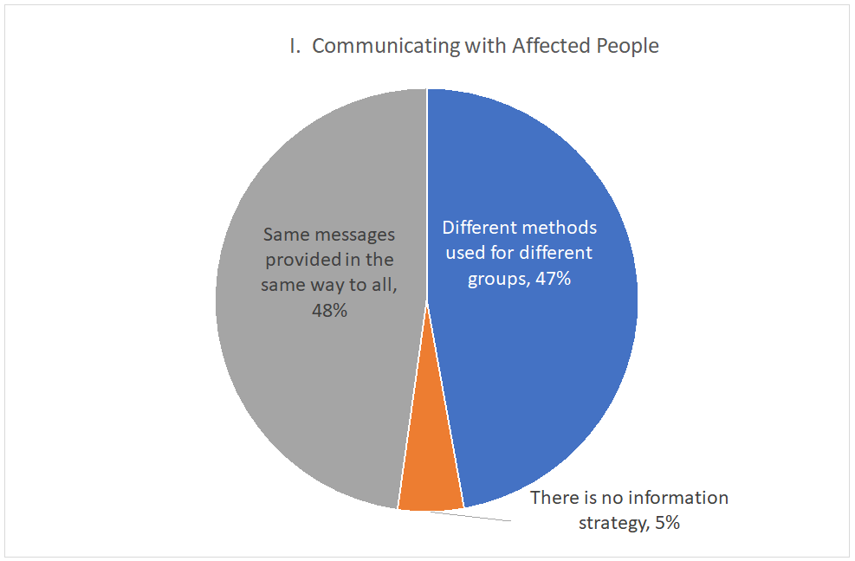
Notes:
These are things that OCHA and many other organizations committed to reporting on under the Grand Bargain PACT agreement. The GAM is the only tool that currently provides data on many aspects of program quality.
Following is a sample of recent monitoring results, showing how GAM helps meet the increasing demand for quantitative information on gender equality in humanitarian response.

Slide 18
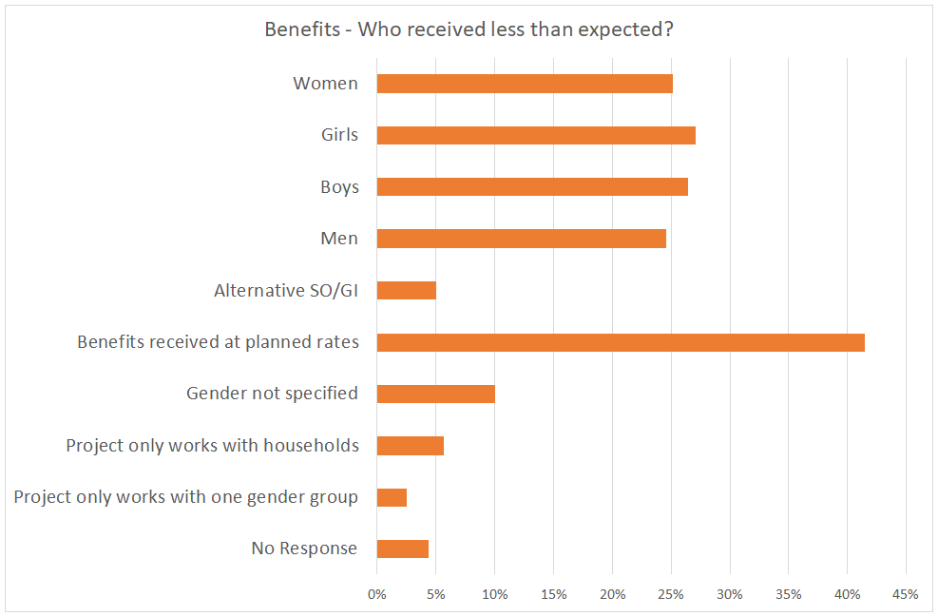
Notes:
These are things that OCHA and many other organizations committed to reporting on under the Grand Bargain PACT agreement. The GAM is the only tool that currently provides data on many aspects of program quality.
Following is a sample of recent monitoring results, showing how GAM helps meet the increasing demand for quantitative information on gender equality in humanitarian response.

Slide 19
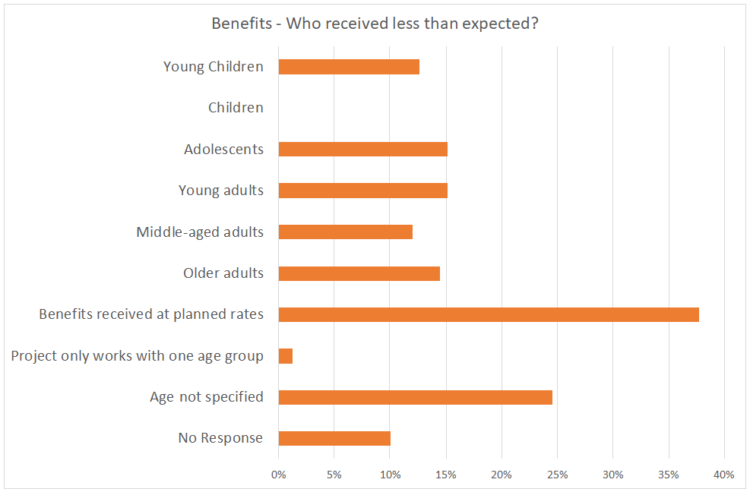

Slide 20
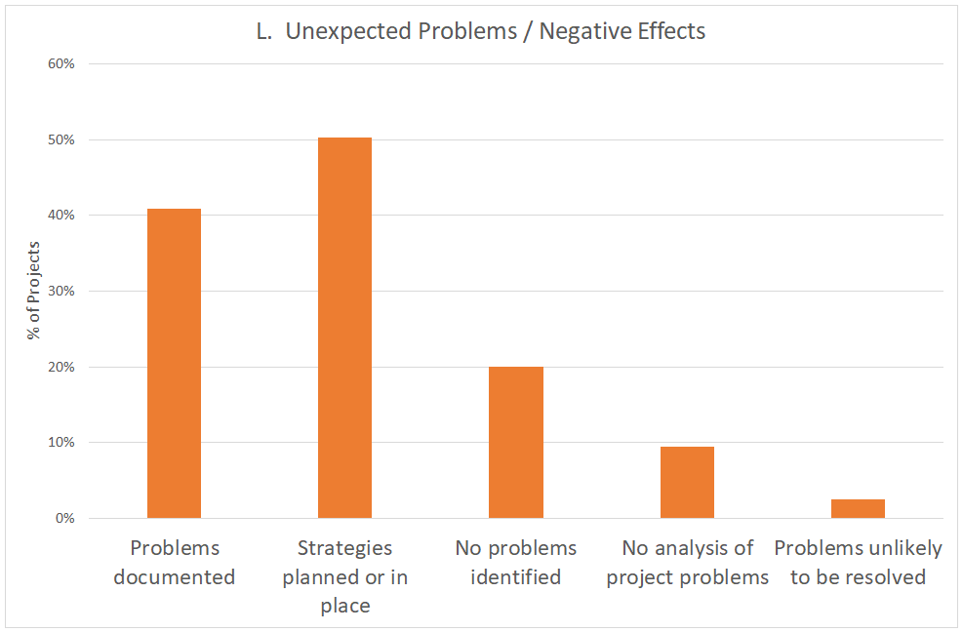
Notes:
These are things that OCHA and many other organizations committed to reporting on under the Grand Bargain PACT agreement. The GAM is the only tool that currently provides data on many aspects of program quality.
Following is a sample of recent monitoring results, showing how GAM helps meet the increasing demand for quantitative information on gender equality in humanitarian response.

Slide 21
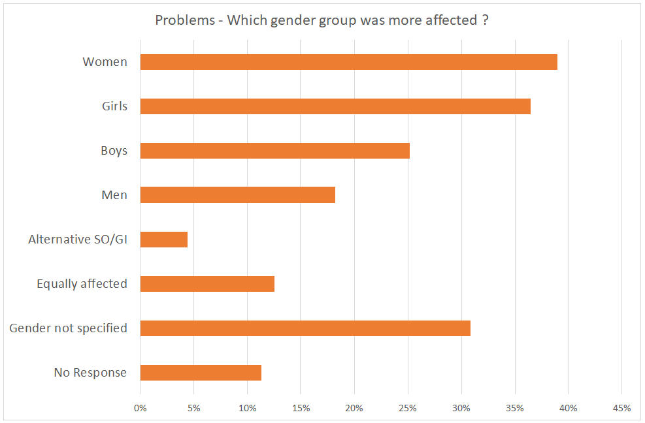
Notes:
These are things that OCHA and many other organizations committed to reporting on under the Grand Bargain PACT agreement. The GAM is the only tool that currently provides data on many aspects of program quality.
Following is a sample of recent monitoring results, showing how GAM helps meet the increasing demand for quantitative information on gender equality in humanitarian response.

Slide 22
Visit the site and try the GAM:
https://iascgenderwithagemarker.com
Contact us to arrange a webinar :
iasc-gam@un.org
Notes:
It is important to keep emphasizing that the purpose of the GAM is not to evaluate or judge projects.
For the GAM is to have its intended impact on project quality, it must be clear that the code received is in no way tied to project acceptance or funding. It should not be used by external actors attempting to judge project quality or enforce compliance with a particular standard.
The GAM offers 12 programming actions to improve attention to gender and age in projects and programs. Teams using the GAM as a design or monitoring exercise consistently report that the GAM draws attention to gender- and age-related concerns that might otherwise have been missed. It provokes discussion about how program actions can do more to reach and involve marginalized people.
It is the process of completing the GAM that improves the quality of action, not the score; users report that when teams sit together to discuss the questions, it draws attention to gender- and age-related concerns that might otherwise have been overlooked.
The only evidence OCHA and donors require – and the best guarantee that gender issues are being considered and addressed – is that the GAM process has been completed.

